Slide 1
Final Project Sim
Or When I Learned To Stop Worrying and Love The Python

Slide 2
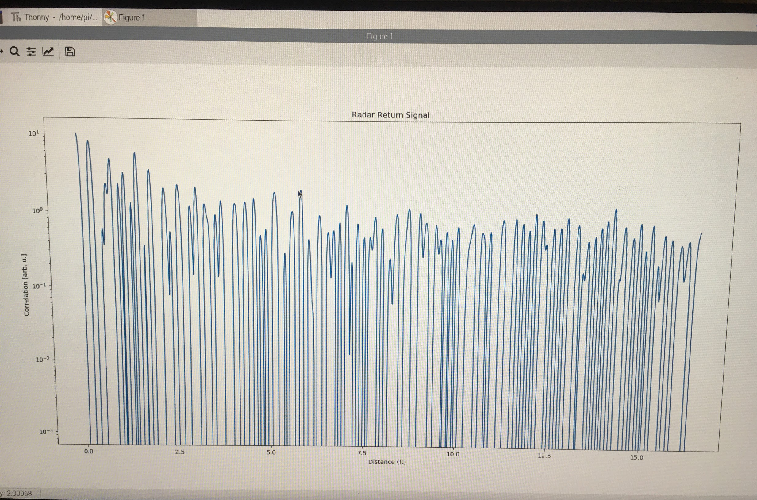
Pictured:
Noise Signal
Ceiling Reflection
Wall Reflection
Decibels levels very high. Opposite what we found outdoors where our transmitted signal dominated our return noise.
Ceiling @ 6.5ft
Wall @ 8.5ft

